Slide 1
COVID-19 Modelling Update (18/03/20) Effect of Repeated “Social” Distancing Measures and Immunity
Alex Morgan, Bram van Bunnik and Mark Woolhouse

Slide 2
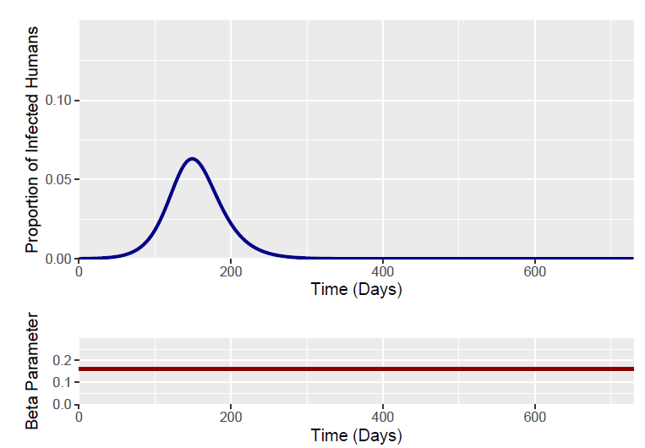
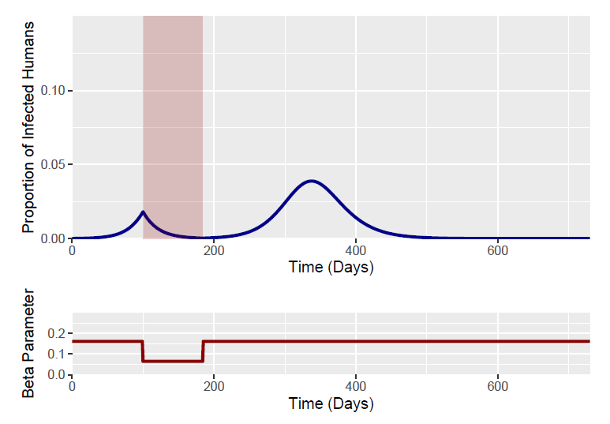
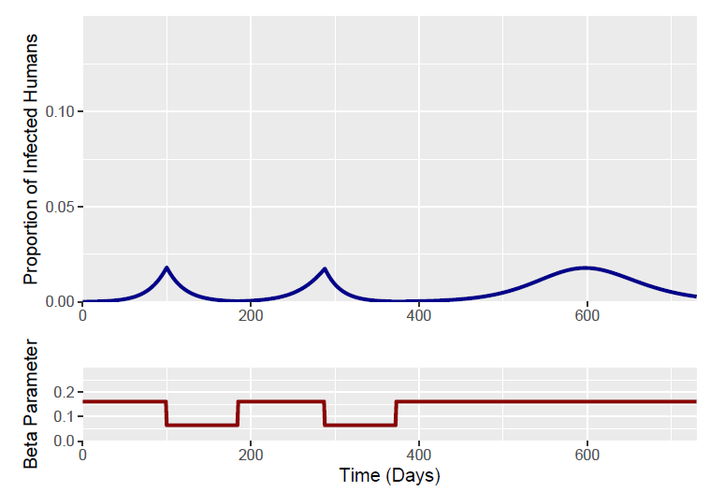
Introduction
Before – 1 Intervention
Bram recently described the effectiveness of social distancing measures (SDM) on COVID-19 epidemic curves
Multiple SDM interventions can suppress multiple epidemic peaks – occurring after lifting previous SDM interventions.
Identified the optimal timing of these interventions
Current questions about the length of immunity after SARS-COV 2 infection…
How does differing levels of immunity affect the epidemic curve and model dynamics?
After – 2 Interventions

Slide 3
Model Structure
SIR Model - Immunity
Compartments
S – Fraction of Population which is SUSCEPTIBLE
I – Fraction of Population which is INFECTIOUS
R – Fraction of Population which is RECOVERED (IMMUNE)
Parameters
β – Rate of transmission
Is a function of the contact rate and probability of infection upon contact
γ – Rate of recovery
Function of the average duration of infectiousness (1/x)
Baseline parameters estimated using R₀ = 2.4 and an Epidemic Doubling Time = 4.6 days
S
βSI
I
γI
R
SIS Model – No Immunity
γI
S
βSI
I
Notes:
We can model and compare two scenarios- worst case scenario – without immunity
We model the current situation – with life long immunity
Reality will likely lay in-between these two scenarios (waning immunity)

Slide 4
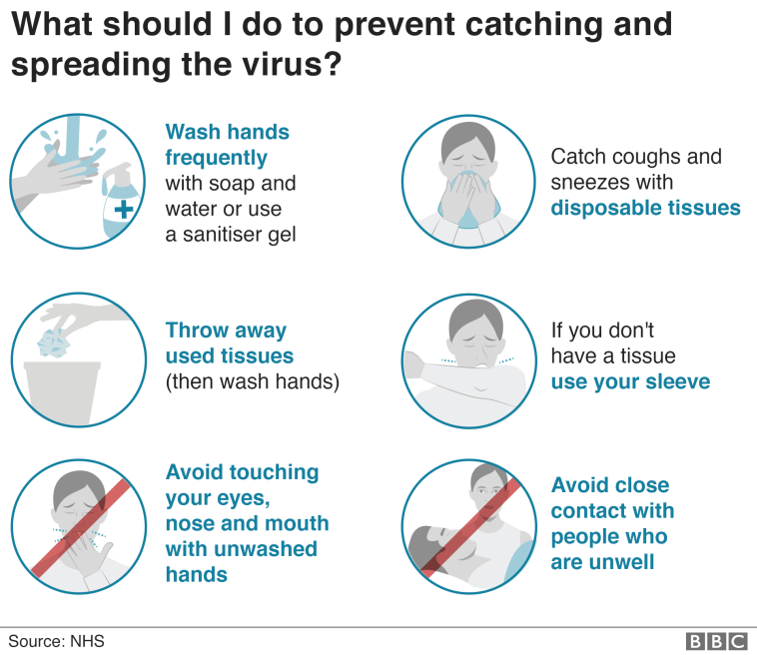
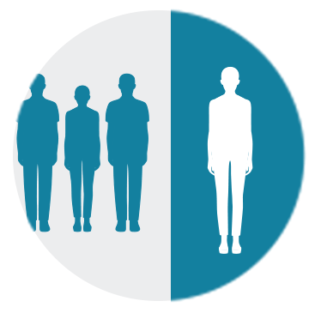

How do we model Social Distancing Measures?
Baseline R₀ = 2.4
37.5% Reduction
60% Reduction
R₀ = 1.5
R₀ = 0.6
We model two social distancing measure interventions lasting for 12 weeks each
(represented through alterations to β)

Slide 5
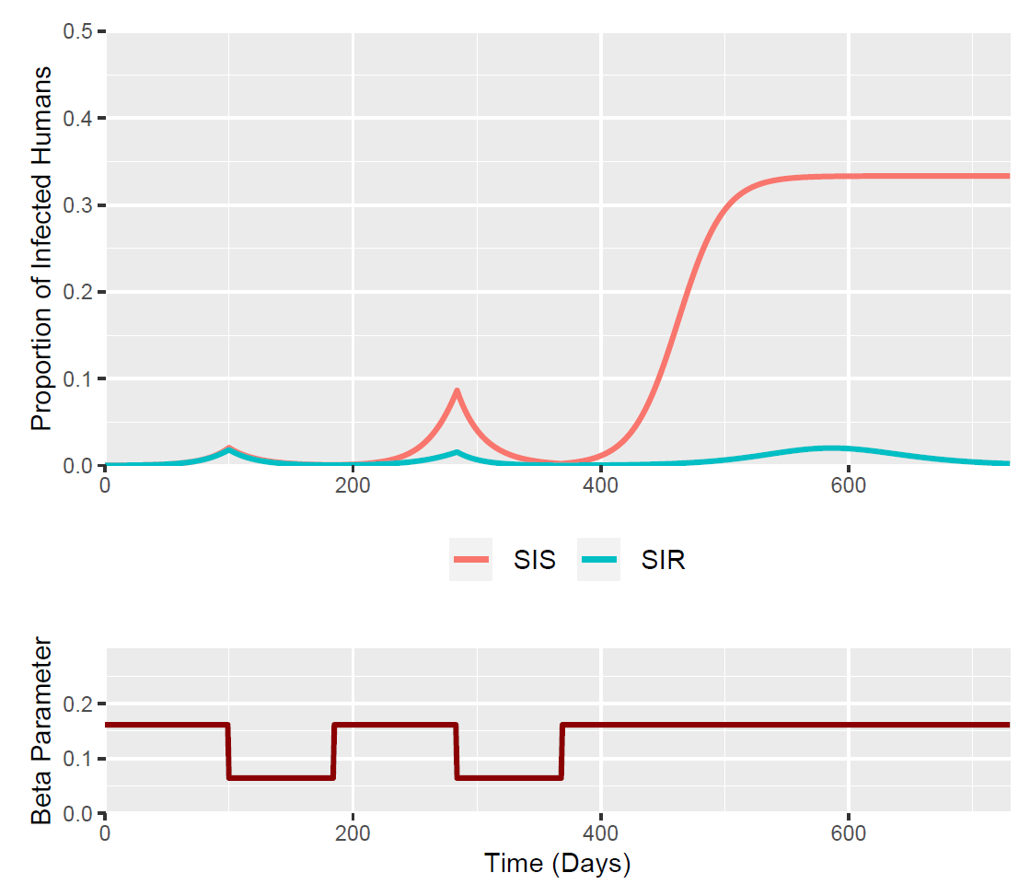
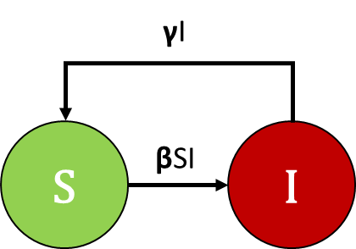

Results
Optimal Timing for Previous SIR Model
Timing of 1st Intervention = 100 days
Timing of 2nd Intervention = 284 days
Apply this to the SIS model…
Take Home Points
Dynamics of 1st epidemic peak very similar despite lack of immunity (SIS).
The susceptibility of the 1st peak populations are very similar across models.
In SIS model - 2nd and 3rd outbreaks are much larger
Due to the replenishment of susceptibles in the SIS model – no immunity after initial peak
Notes:
We only model 2 internvetions – if we had multiple interventions we would be able to supress the epidemic indefinitely

Slide 6
Summary
For the immediate future (the incoming 1st wave of a UK COVID outbreak):
Different assumptions about immunity will not affect the efficacy of interventions
Due to similar levels of susceptibility during initial outbreak
However, it will affect subsequent rebounding outbreaks…
If we use incorrect assumptions about immunity – severity of subsequent outbreaks could be worse than anticipated.
Research on the presence of immunity important when planning for “rebounding” epidemics after the 1st peak.

